Slide 1

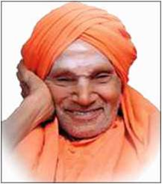
SIDDAGANGA INSTITUTE OF TECHNOLOGY, TUMAKURU
Major project presentation
on
VEHICLE DETECTION AND SPEED ESTIMATION USING DEEP LEARNING
Under the guidance of
B.A SRIDHARA M.E
Associate professor
Dept. of EEE
Presented by:
ANUSHA 1SI18EE005
NIDHI T 1SI18EE028
SANIYA KOUSER 1SI18EE046
VYSHNAVI G L 1SI18EE059
Dept. of EEE
2021-22

Slide 2
INDEX
Introduction
Literature survey
Objective
Problem statement
Product and it’s role
Equations used in speed Estimation
Block diagram
Speed Estimation
Project model
Flowchart
Output for the speed Estimation
Project Challenges
Result analysis

Slide 3

INTRODUCTION
Road safety is an important factor for the police force. And as citizens it is our responsibility to follow rules and maintain safety on our roads. This project is able to estimate speed of vehicles and save vehicle data.
A robust and reliable vehicle detection and speed estimation system alerts drivers about driving conditions
This includes the detection of moving vehicles, estimation of their speed and detection of the speed limit violation.
Here we detect and tracks the vehicle passing through the surveillance area, vehicles tracking is based on the relative positions of the vehicles in consecutive frames and keeps the record of vehicles position
And it indicates those over speed vehicles in red color and alerts the traffic manager.

Slide 4
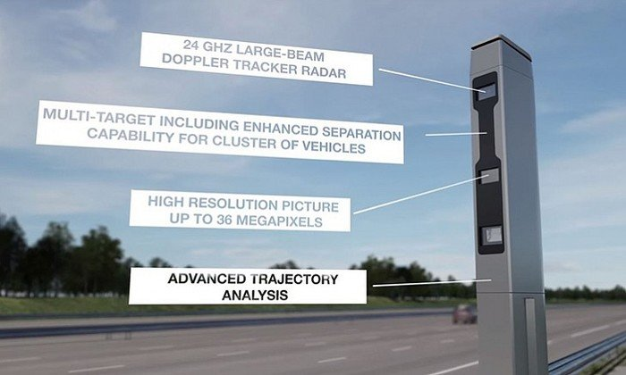

Slide 5
LITERATURE SURVEY
PAPER | AUTHOR and YEAR OF THE JOURNAL/CONFERNCE | KEY LEARNING’S
Vehicle Speed Detection from Camera stream using Image processing methods. | J. Gerat, D. Sopiak, M. Oravec and J. Pavlovicova (Volume: 07 Issue: 05 | May 2020 ) | Detection of Vehicle Position and Speed using Camera Calibration and Image Projection Methods
A Deep Learning Approach to Vehicle Speed Estimation | Benjamin Penchas , Tobin Bell , Marco Monteiro (2016 International Conference on Computer) | Determining vehicle speed based on video using convolutional neural network
An Efficient Approach for Detection and Speed Estimation of Moving Vehicles | Tarun Kumar and Dharmender Singh Kushwaha (2018 IEEE/CVF Conference on Computer Vision ) | Vehicle speed measurement model for video-based systems
Vehicle Detection, Tracking, and Speed Estimation Using Deep Learning and Computer Vision | Shiksha Jaiswal, Shristi V. Kotaiah Chaurasia Sandeep (2017 International Symposium) | An Efficient Approach for Detection and Speed Estimation of Moving Vehicles

Slide 6
OBJECTIVES
The main objective of the project is to detect the speed using Image Processing in Python by using OpenCV and to save vehicle data.

Slide 7
PROBLEM STATEMENT
When it comes to tracking the speed of vehicles on a segment of road, the vital steps of this projects is:
Vehicle Detection
Speed estimation
Capturing vehicle picture

Slide 8
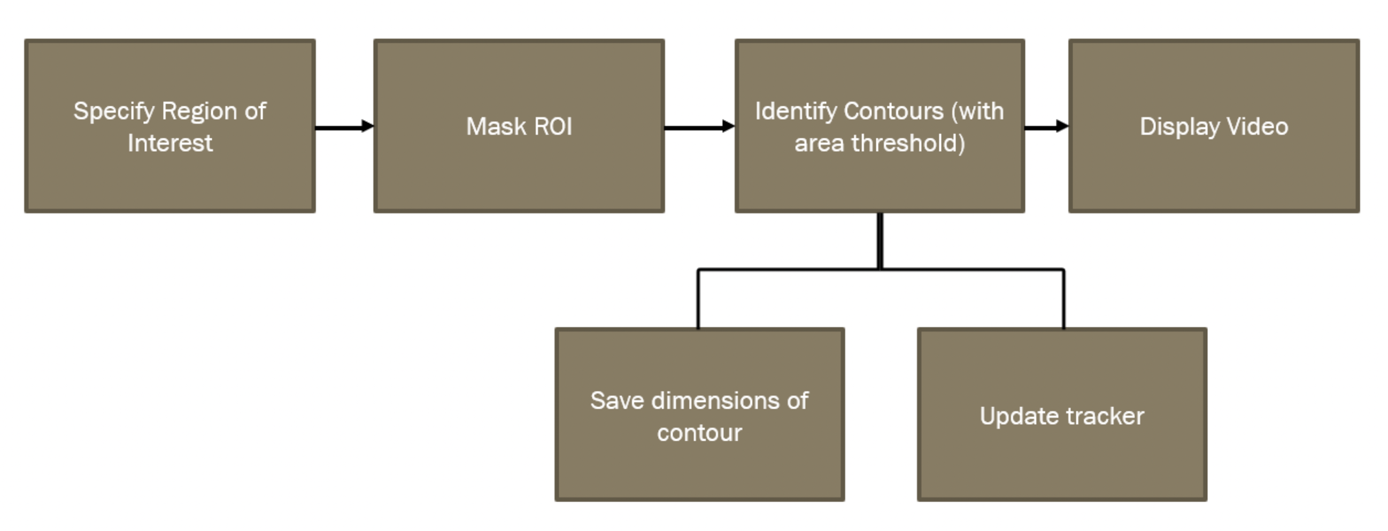
Vehicle Detection
As the background of the vehicles is stationary image subtraction is used to detect moving vehicle.

Slide 9
Speed Estimation
The speed of a vehicle can be estimated when a tracked vehicle covers a segment of road.
Contour detection
Based on Contour detection, the image of a particular ID is saved to a folder along with the speed. Picture is saved as soon as the speed is estimated.

Slide 10


CAPTURE IMAGE and
SAVE SPEED
END TIMER s2[ID]
Timing array:
S1= start timer
S2= stop timer
START
TIMER
s1[ID]

Slide 11
Technologies used
Image processing
Python
Segmentation technique
Morphological transformations
Background subtraction algorithm
Kernal based algorithm
Libraries Used
OpenCV
NumPy
Software Description:
Visual studio

Slide 12
Video Acquisition
Image Recognition and region of interest monitored
Speed Calculation
Save Vehicle Image
Define Region of Interest
Image Subtraction
Start Timer and Save in array
Crop Image based in Contour Detections
Masking and Erosion
Stop Timer and Save in Array
Save Vehicle Image in File
Contour Detection
Calculate Speed and save in array
Save ID and speed in Text File
PROJECT MODEL
Object Tracking
Display on Bounding Box
Add Summary at end of text file
Draw Bounding Box

Slide 13
In speed determination vehicle detection and vehicle tracking are the key steps.
The video stream of the moving vehicle is given as an input, then it is passed through the filter for detecting its speed. It uses the live video stream from the surveillance cameras.
The speed of vehicle is updated , hence keeping a track on acceleration and deceleration of vehicle in the field of view of the camera.
Any violation in the speed laws can be observed and notified to the officer of law. The video can also be saved for future use.

Slide 14
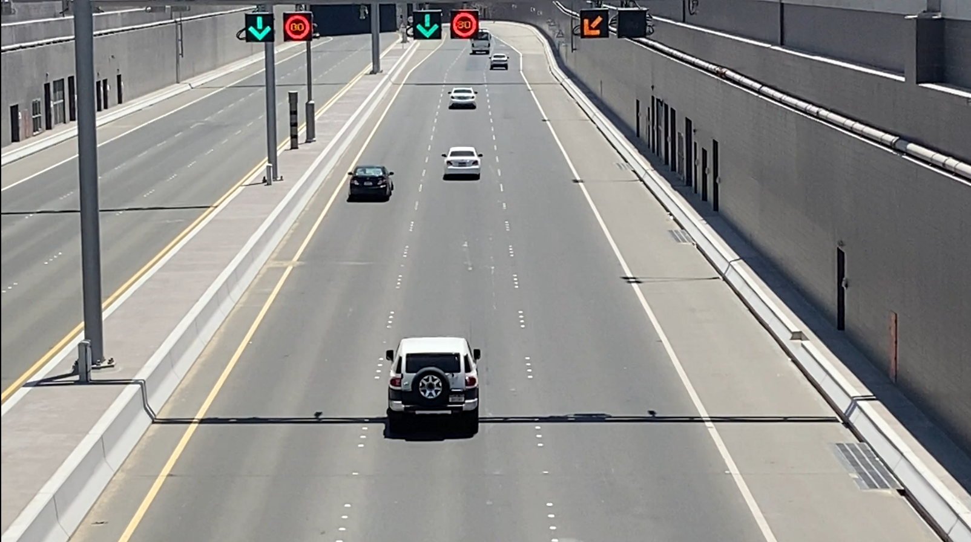
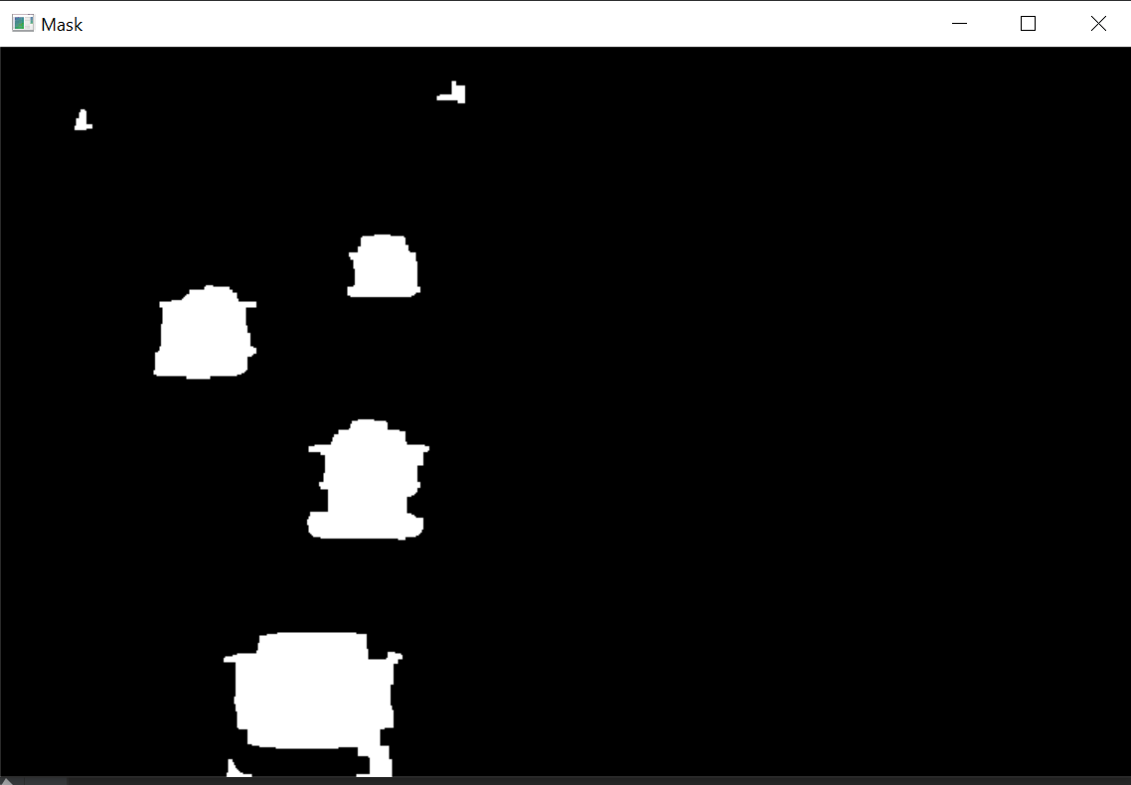
Object Tracking
DETECT CONTOURS
ELIMINATE
BASED ON AREA
OBJECT TRACKER

Slide 15
IMPLEMENTATION IN VISUAL STUDIO
Video Acquisition
Region of Interest and Masking
Contour Detection
Object Tracking
Speed Estimation
Timer Start and stop
Speed Formula
Drawing Rectangles and displaying on the screen
Drawing Reference Lines
Save Vehicle Images and speeds
Create Summary

Slide 16
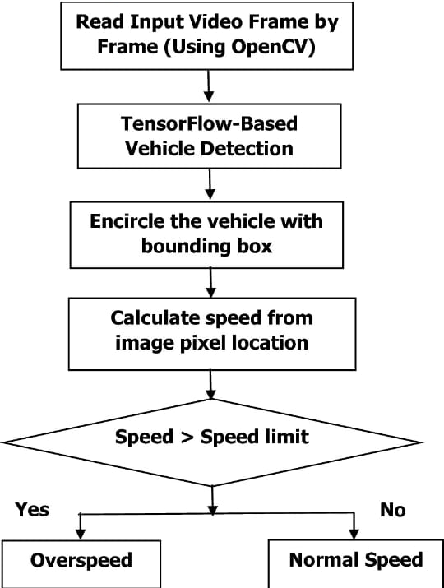
FLOWCHART:
BGS

Slide 17
ALGORITHM
Step1- The recorded video is given as input frame by frame using openCV.
Step 2- Object is detected by using Image substraction.
Step3 .. The object is tracked and bounding box encircle the vehicle according to the area threshold
Step4- Speed is calculated from the Time difference between the position of a vehicle and displayed on top of bounding box
Step-5 speed limit is checked i.e. 80 kmph
Step 6- if current speed of vehicle is above speed limit then data of violators is pointed out saved with the summary

Slide 18
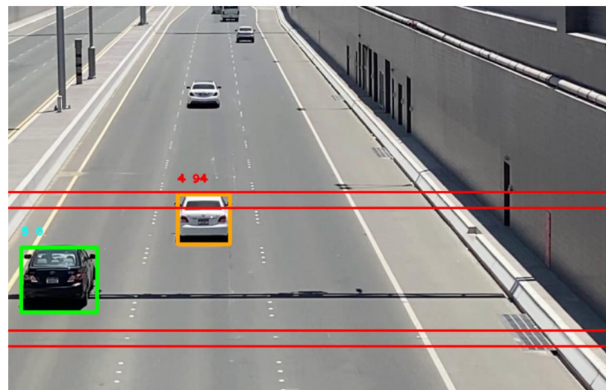
OUTPUT FOR SPEED ESTIMATION
https://drive.google.com/drive/folders/1mWC8kLqgro5Po8hIQhdksOCd_ypOmXjs

Slide 19
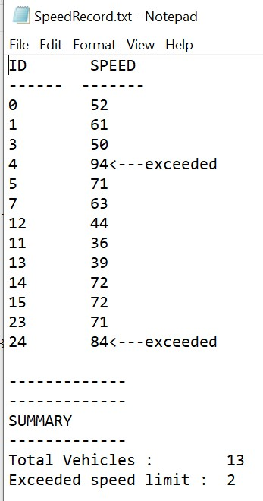
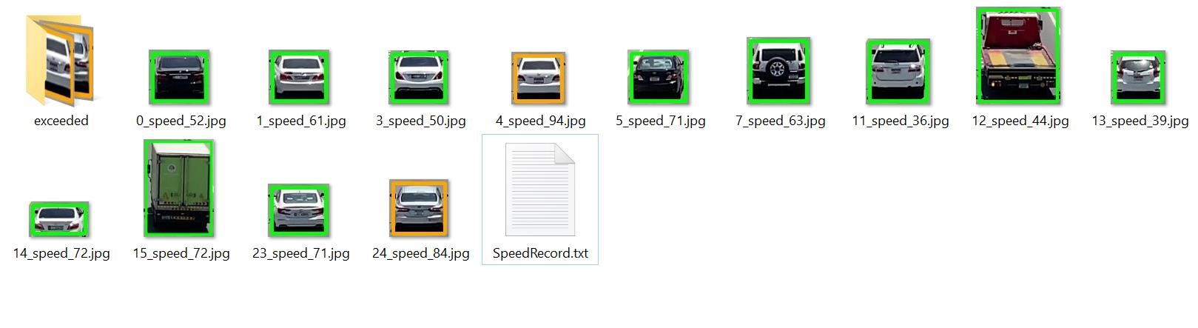
Saved Vehicle Data
2. Saved Image Pictures

Slide 20
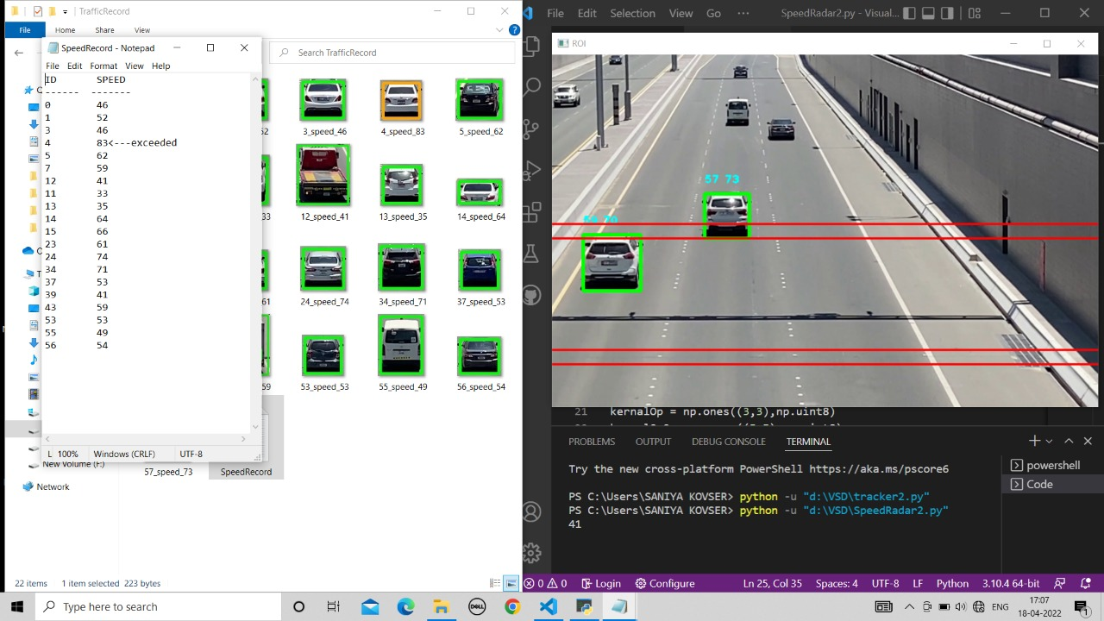

Slide 21
Result analysis
This project is successfully able to track vehicles and estimate their speed.
Accuracy in detecting vehicles as long as there is no movement in the camera. Estimation of speed can have a difference of 0-2 km/hr depending of the program execution speed.
Multiple vehicles can be detected, and their speeds can be detected. However if two vehicles are moving extremely close to each other, it may be detected as a single object.
This project requires the camera to be as still as possible, as movement is used to distinguish vehicles from the background.

Slide 22
Project Challenges
1.Objects that weren’t vehicles were being detected
2.Multiple vehicles speeds were unable to be detected
3.Vehicles close together were clubbed as single object

Slide 23
CONCLUSION
This output method gives better results as compared to previous techniques.
Background subtraction is robust against illumination changes in real world.
Also by extracting ROI the noise immunity is improved.
As the distance is mapped on the image by calculating it from real world. So the calculated speed is approximated to actual speed.

Slide 24
FUTURE SCOPE
1. Number plate detection.
2. Speed detection of small and large vehicles
3. Live speed detection

Slide 25
THANK YOU

